Slide 1
Effort Creates Ability

Slide 2
Why should I care about college?
No matter how you cut it, more education pays. There is a sizeable economic return to going to college and earning at least a two- or four-year degree. The 33 percent of Bachelor’s degree holders that continue on to graduate from master’s programs, doctoral programs and professional schools have even more prosperous futures ahead. Moreover, the diﬀerence in earnings between those who go to college and those who don’t is growing — meaning that postsecondary education is more important than ever.
- Georgetown University Center on Education and the Workforce, 2016

Slide 3
Why should I care about college?
The difference in lifetime earnings between a high school graduate and a college grad who earns a B.A. is estimated to be $964,000.

Slide 4
Lifetime Earnings by Education Level

Slide 5
Top 10 Jobs with less than HS Diploma
Occupation | % of the workforce | Lifetime Earnings 2009 dollars
Driver/Sales Worker and Truck Drivers | 6.1% | $1,300,000
Janitors and Custodians | 4.6% | $855,000
Cooks | 3.3% | $761,000
Construction Laborers | 3.2% | $1,037,000
Maids and Housekeeping | 3.1% | $663,000
Laborers and Material Movers | 2.9% | $965,000
Maintenance Workers | 2.7% | $772,000
Other Agricultural Workers | 2.6% | $814,000
Other Production Workers | 2.3% | $980,000
Carpenters | 2.2% | $1,069,000

Slide 6
Top 10 Jobs with a HS Diploma
Occupation | % of the workforce | Lifeteime Earnings in 2009 Dollars
Driver/Sales Worker and Truck Drivers | 4.9% | $1,531,000
Secretaries and Administrative Assistants | 3.7% | $1,264,000
Supervisors/Managers of Retail Sales | 3.3% | $1,345,000
Janitors and Custodians | 2.6% | $1,048,000
Laborers and Movers | 2.2% | $1,199,000
Retail Salespersons | 1.8% | $1,134,000
Nursing and Home Health Aides | 1.8% | $966,000
Other Production Workers | 1.8% | $1,308,000
Other Managers | 1.7% | $1,876,000
Supervisors/Managers of Production | 1.6% | $1,809,000

Slide 7
Top 10 Jobs with a Bachelor’s Degree
Occupation | % of the workforce | Lifetime Earnings in 2009 Dollars
Elementary and Middle School Teachers | 5.1% | $1,757,000
Other Managers | 4.6% | $3,094,000
Accountants and Auditors | 4.6% | $2,422,000
Registered Nurses | 4% | $2,527,000
Wholesale and Manufacturing Sales Reps | 2.5% | $3,062,000
Supervisor/Manager of Retail Sales | 2.3% | $1,807,000
Chief Executives | 1.9% | $4,483,000
Financial Managers | 1.9% | $3,081,000
Computer Software Engineers | 1.8% | $3,554,000
Marketing/Sales Managers | 1.8% | $3,494,000

Slide 8
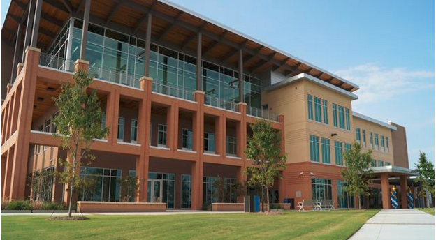
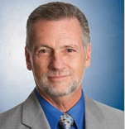
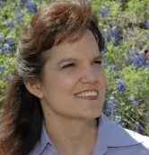
Colorado River Collegiate Academy
Austin Community College, our IHE Partner
Dr. Richard Rhodes
ACC President
Dr. Melissa Biegert
ACC Director of Early College High Schools

Slide 9
Why can’t I just wait to earn college credits after High School?
The 60 hours of college credit you will earn through CRCA is FREE.
If you paid for 60 hours of credit at ACC the cost would be $21,780.* - an increase of $4640 from last year.
Books - $6,000
If you paid for these 60 hours of credit at the UT @ Austin or TAMU the cost would be $26,770.**
Do the Math! *2017 Tuition **College of Liberal Arts

Slide 10
CRCA Application Process
The applicant must:
reside in the Bastrop Independent School District.
meet ALL requirements for promotion from eighth grade to ninth grade.
complete the four admission essays as a part of this application.
interview with the staff of the Colorado River Collegiate Academy.
must attend a two-week Summer Bridge Program in June of 2018.
understand competitive sports and fine arts are not offered at CRCA.
understand that a lottery process will be used if more than 70 qualified students apply.

Slide 11
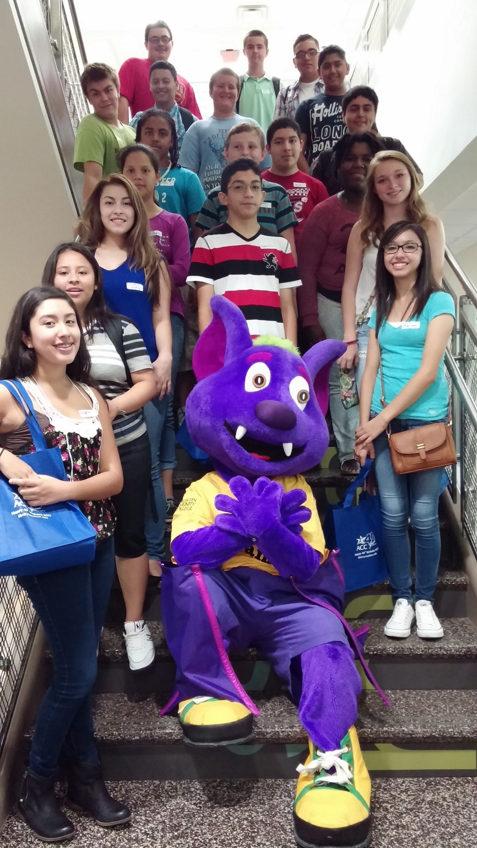
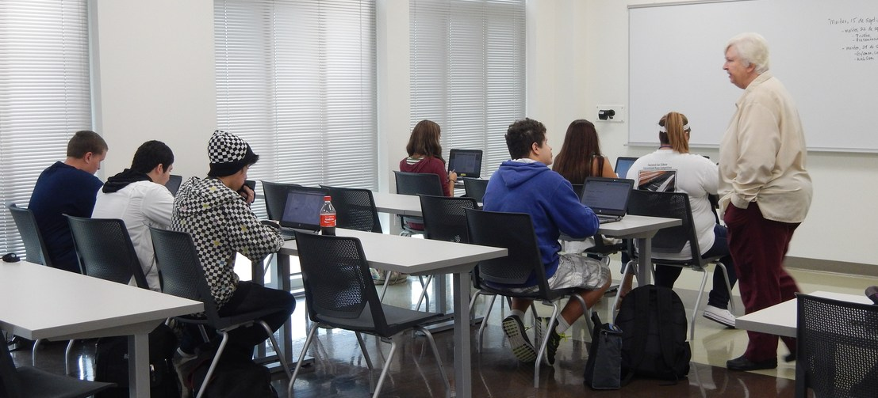
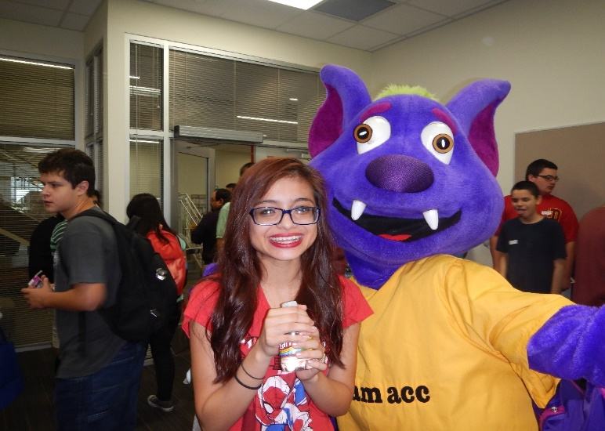
We Are ACC!

Slide 12
What Associate Degree Programs are Available?
General Studies in Liberal Arts (AA)
General Studies in Science (AS)
Pre – Veterinary (AS)* Available in 2018

Slide 13
What Do I Do if I am Interested?
Pick up a Student Application from your school counselor or download it from our website.
Pick it up and complete the application between today and December 22nd/March 29th.
Make sure your application is complete, including written interview section.
Applications are due in the counselors’ office on December 22nd/March 29th.

Slide 14
How Do I Qualify?
Your student application, including your written essays, will be reviewed by the CRCA Application Committee.
The students who qualify will participate in an interview with the CRCA principal and interview committee.

Slide 15
Questions
Martin Conrardy, CRCA Principal
mconrardy@bisdtx.org
512.772.7230
Rick Longoria, CRCA Counselor
rlongoria@bisdtx.org
512.772.7230
Contact Information

